Slide 1


BUILDING
FAITH through PRAYER
International Women’s Day of Prayer
General Conference
Women’s Ministries
Written by
Premila Masih
Southern Asia Division
Women’s Ministries Director

Slide 2

“Consequently, faith comes from hearing the message, and the message is heard through the word about Christ.”
Romans 10:17 (NIV)

Slide 3

In Matthews 15:21-28, the story is told of a Canaanite woman who crept up to Jesus, certain He could help with a problem that weighed heavily on her heart.

Slide 4

“In faith the woman of Phoenicia flung herself against the barriers that had been piled up between Jew and Gentile. Against discouragement, regardless of appearances that might have led her to doubt, she trusted the Savior's love. It is thus that Christ desires us to trust in Him.” Conflict and Courage, 297

Slide 5

But Joshua spared Rahab the prostitute, with her family and all who belonged to her, because she hid the men Joshua had sent as spies to Jericho--and she lives among the Israelites to this day.
Joshua 6:25 (NIV)

Slide 6
By faith the prostitute Rahab, because she welcomed the spies, was not killed with those who were disobedient.
Hebrews 11:31 (NIV)

Slide 7
“By faith Noah, when warned about things not yet seen, in holy fear built an ark to save his family.”
Hebrews 11:7 (NIV)

Slide 8
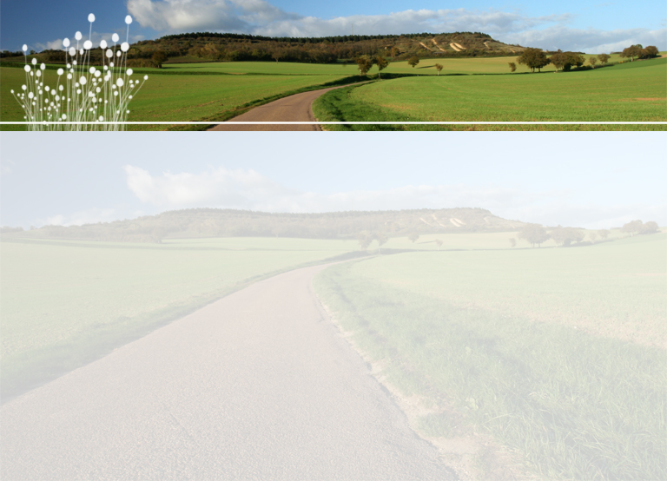
Though he slay me, yet will I hope in him; I will surely defend my ways to his face.
Job 13:15 (NIV)

Slide 9

"Naked I came from my mother's womb, and naked I will depart. The LORD gave and the LORD has taken away; may the name of the LORD be praised.”
Job 1:21 (NIV)

Slide 10

“’Shall we accept good from God, and not trouble?’
Job 2:10(NIV)

Slide 11
“The very trials that task our faith most severely and make it seem that God has forsaken us, are to lead us closer to Christ, that we may lay all our burdens at His feet and experience the peace, which He will give us in exchange.”
Patriarchs and Prophets, p. 129

Slide 12
“We must be partakers with Christ of His sufferings, if we would sit down in triumph with Him on His throne. So long as we choose the easy path of self-indulgence, and are frightened at self-denial, our faith will never become firm, and we cannot know the peace of Jesus, nor the joy that comes through conscious victory.”
Christian Experience and Teachings of Ellen G. White, 184.

Slide 13
Faith in Jesus, such submission at the feet of Jesus, brings nothing but healing; it brings life; it brings joy; its bring light; it brings wholeness because Jesus is the living Word of God. We can trust in His love.

